Slide 1

Operating systems
I/O Management, System Protection and Security
Venkatesh Prasad
Department of Computer Science

Slide 2
Operating systems
System Security - System and Network Threats
Venkatesh Prasad
Department of Computer Science
Notes:
To discuss security threats and attacks

Slide 3
OPERATING SYSTEMS
Slides Credits for all PPTs of this course
The slides/diagrams in this course are an adaptation, combination, and enhancement of material from the following resources and persons:
Slides of Operating System Concepts, Abraham Silberschatz, Peter Baer Galvin, Greg Gagne - 9th edition 2013 and some slides from 10th edition 2018
Some conceptual text and diagram from Operating Systems - Internals and Design Principles, William Stallings, 9th edition 2018
Some presentation transcripts from A. Frank – P. Weisberg
Some conceptual text from Operating Systems: Three Easy Pieces, Remzi Arpaci-Dusseau, Andrea Arpaci Dusseau

Slide 4
OPERATING SYSTEMS
System and Network Threats
Some systems “open” (i.e more services are enabled and more functions are allowed) rather than secure by default
Reduce attack surface
But harder to use, more knowledge needed to administer
Network threats harder to detect, prevent
Protection systems weaker
More difficult to have a shared secret on which to base access
No physical limits once system attached to internet
Or on network with system attached to internet
Even determining location of connecting system difficult
IP address is only knowledge

Slide 5
OPERATING SYSTEMS
System and Network Threats (Cont.)
Worms – use spawn mechanism; standalone program
Internet worm
Exploited UNIX networking features (remote access) and bugs in finger and sendmail programs
Exploited trust-relationship mechanism used by rsh to access friendly systems without use of password
Grappling hook (aka bootstrap or vector) program uploaded main worm program
99 lines of C code
Hooked system then uploaded main code, tried to attack connected systems
Also tried to break into other users accounts on local system via password guessing
If target system already infected, abort, except for every 7th time

Slide 6
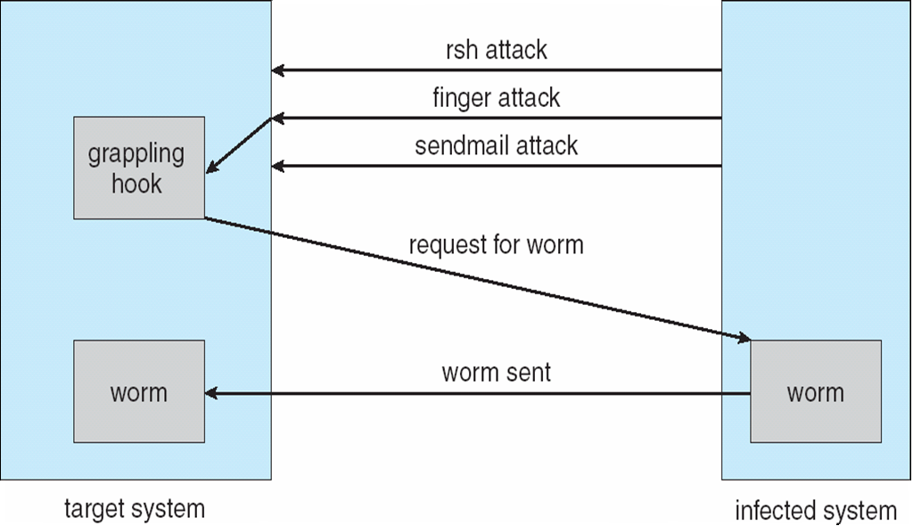
OPERATING SYSTEMS
The Morris Internet Worm
Notes:
Allowing every seventh duplicate to proceed (possibly to confuse/surprise efforts to stop its spread by baiting with “fake” worms) created a
wholesale infestation of Sun and VAX systems on the Internet.

Slide 7
OPERATING SYSTEMS
Sobig.F Worm
Disguised as a photo uploaded to newsgroups via account created with stolen credit card
Targeted Windows systems
Had own SMTP engine to mail itself as attachment to everyone in infect system’s address book
Disguised with innocuous subject lines, looking like it came from someone known
Attachment was executable program that created WINPPR23.EXE in default Windows system directory and modified the Windows Registry
[HKCU\SOFTWARE\Microsoft\Windows\CurrentVersion\Run] "TrayX" = %windir%\winppr32.exe /sinc [HKLM\SOFTWARE\Microsoft\Windows\CurrentVersion\Run] "TrayX" = %windir%\winppr32.exe /sinc

Slide 8
OPERATING SYSTEMS
System and Network Threats (Cont.)
Port scanning
Automated attempt to connect to a range of ports on one or a range of IP addresses
Detection of answering service protocol
Detection of OS and version running on system
nmap scans all ports in a given IP range for a response
nessus has a database of protocols and bugs (and exploits) to apply against a system
Frequently launched from zombie systems
To decrease trace-ability

Slide 9
OPERATING SYSTEMS
System and Network Threats (Cont.)
Denial of Service
Overload the targeted computer preventing it from doing any useful work
Distributed denial-of-service (DDOS) come from multiple sites at once
Consider the start of the IP-connection handshake (SYN)
How many started-connections can the OS handle?
Consider traffic to a web site
How can you tell the difference between being a target and being really popular?
Accidental – CS students writing bad fork() code
Purposeful – extortion, punishment

Slide 10

THANK YOU
Venkatesh Prasad
Department of Computer Science Engineering
venkateshprasad@pes.edu

